Slide 1
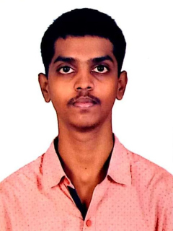
CAPSTONE PROJECT Real-Time Thermal Simulation Module
Presented By
Student Name: Sangepu Chandra Shekar
College Name: Sree Dattha Institute Of Engineering And Science
Department: Mechanical Engineering
Email ID: sangepu.chandu76@gmail.com
AICTE Student ID: STU679712a2471081737953954

Slide 2
OUTLINE
Problem Statement (Should not include solution)
Proposed System/Solution
System Development Approach (Technology Used)
Algorithm & Deployment
Result (Output Image)
Conclusion
Future Scope
References

Slide 3
Problem Statement
In situations like pandemics or in high-security environments, keeping an eye on human body temperature is essential for spotting fevers and potential illnesses early on. Traditional infrared thermal scanners can be quite pricey, and manual temperature checks take a lot of time and require close contact. This project aims to fill the gap by offering a low-cost, contactless, real-time temperature screening solution that utilizes a regular webcam along with some basic computer vision techniques.

Slide 4
Proposed Solution
Our system uses a webcam to detect faces in real-time and estimates average facial temperatures by mimicking thermal imagery through grayscale normalization. The output is presented with a thermal-like colormap, complete with overlaid temperature readings.
Data Collection:
Source: Live video feed from the system’s webcam.
Content: Continuous video frames featuring human faces and the surrounding background.
Acquisition Rate: Real-time (approximately 30 frames per second, depending on system performance).
Data Preprocessing:
Grayscale Conversion: This step helps to lighten the computational load.
Normalization: Grayscale values are scaled between 20–40°C to simulate thermal data.
Color Mapping: We apply (COLORMAP_JET) to visualize temperature ranges as thermal imagery.
Machine Learning Algorithm:
Algorithm Used: Haar Cascade Classifier (a rule-based, pre-trained method, not your typical ML approach).
Functionality: Detects human faces using rectangle-based Haar-like features.
Fast and lightweight, making it suitable for real-time applications.

Slide 5
Deployment:
Environment: Local Python setup on a PC or laptop.
Libraries: OpenCV, NumPy.
Hardware: A standard USB webcam.
Execution: Real-time detection and visualization.
The process ends smoothly when the 'q' key is pressed.
Evaluation:
Accuracy: Reliable for detecting frontal faces in good lighting conditions.
Performance: Real-time performance on standard computers.
Light enough for Raspberry Pi or edge deployment with some optimization.
Limitation: Simulated temperature readings are not medically accurate.
Works best in controlled lighting and angles.
Result:
Successfully detects human faces.
Overlays temperature based on simulated thermal data.
Outputs a thermal camera effect with average temperature shown for each face.

Slide 6
System Approach
The "System Approach" section outlines the overall strategy and methodology for developing and implementing the Thermal scanner. Here's a suggested structure for this section:
COMPONENT | Technology / Library
Programming | Python 3.x
Image Processing | OpenCV
Numeric Processing | NumPy
Detection Model | Haar Cascade Classifier
Hardware | Built-in or USB Webcam
OS Support | Windows, Linux, macOS

Slide 7
Algorithm & Deployment
Algorithm Selection:
Chosen Algorithm: Haar Cascade Classifier (from OpenCV).
Reason: It is fast, lightweight, and suitable for real-time face detection using traditional computer vision. It doesn't require a GPU and works well in frontal face scenarios.
How it Works: Uses Haar-like features (edge, line, and rectangle patterns). Trained using the AdaBoost algorithm to build a cascade of weak classifiers.
Provided as a pre-trained XML file by OpenCV.
Data Input:
Source: Webcam live feed (cv2.VideoCapture(0)).
Type: Real-time video frames.
Preprocessing: Each frame is converted to grayscale (cv2.cvtColor()).
The grayscale image is normalized to a temperature range (20–40°C) using cv2.normalize() to simulate thermal data.
The simulated data is visualized with cv2.applyColorMap().

Slide 8
Training Process:
Note: No training is performed in your project.
The Haar cascade model is already trained on thousands of positive (face) and negative (non-face) images.
The training process was carried out by OpenCV contributors and saved as an XML file (haarcascade_frontalface_default.xml), which your code loads directly.
Prediction Process:
Step 1: Read a frame from the webcam.
Step 2: Convert it to grayscale for processing efficiency.
Step 3: Use detectMultiScale() to identify face regions.
Step 4: For each detected face: Extract the face region from the normalized grayscale image (simulated temperature map).
Calculate the average temperature in that region using NumPy (np.mean()). Overlay the bounding box and temperature label on the thermal-color-mapped frame.
Step 5: Display the frame until the user exits with the 'q' key.

Slide 9
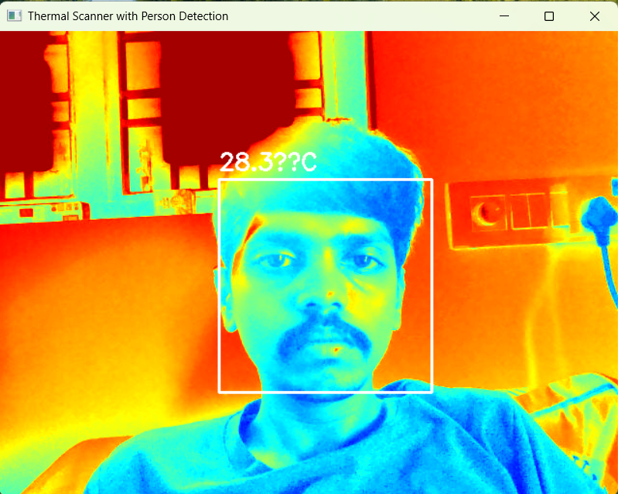
Result
Live thermal-style view with face detection and temperature overlay.
Smooth performance with minimal lag on standard systems.
Effective face tracking when users look directly into the camera.
Limitations:
Only simulates temperature (does not measure actual heat).
Accuracy dependent on lighting and camera resolution.
OUTPUT :

Slide 10
Conclusion
The project demonstrates a viable low-cost prototype for thermal scanning using computer vision. While it doesn't replace true thermal cameras, it effectively simulates a similar experience using a webcam and face detection, making it suitable for educational, experimental, or pre-deployment scenarios.

Slide 11
Future scope
Real Sensor Integration: Use an actual thermal sensor (e.g., FLIR Lepton).
Enhanced Detection: Replace Haar cascades with deep learning models (e.g., YOLOv5).
Mobile App: Port the solution to Android/iOS using OpenCV Mobile or ML Kit.
Cloud Logging: Store time-stamped detections and temperature records.
Alert System: Trigger alerts if a face’s temperature exceeds a threshold.
Multi-face Support: Handle crowd detection with parallel processing.

Slide 12
References
OpenCV Documentation – https://docs.opencv.org/
Colormaps in OpenCV – https://docs.opencv.org/master/d3/d50/group__imgproc__colormap.html
Haar Cascades – https://docs.opencv.org/3.4/db/d28/tutorial_cascade_classifier.html
***This is the GitHub Link For my Project***
GitHub Link: https://github.com/Chandrashekar-1/Real-Time-Thermal-Simulation-Module.git

Slide 13
Thank you

